Slide 1
Chapter 2
Application Layer
2-<number>

Slide 2
Chapter 2: Application layer
2.3 FTP
2-<number>

Slide 3
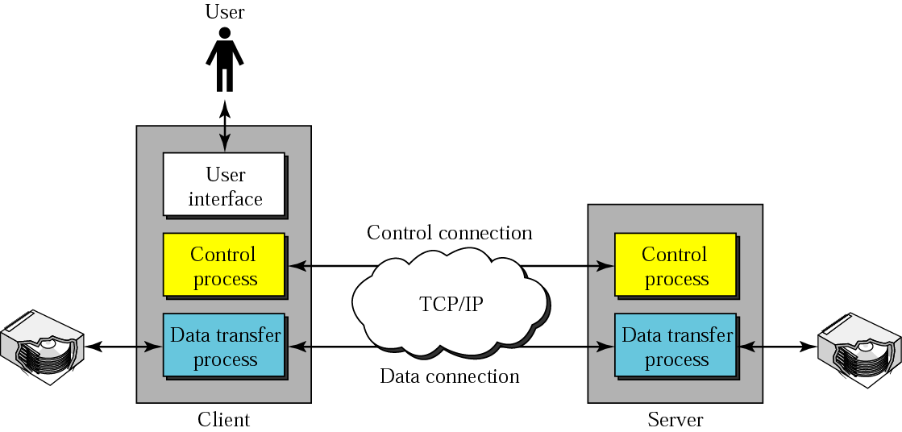
FTP
FTP uses the services of TCP. It needs two TCP connections.
The well-known port 21 is used for the control connection and
the well-known port 20 for the data connection.
2-<number>

Slide 4
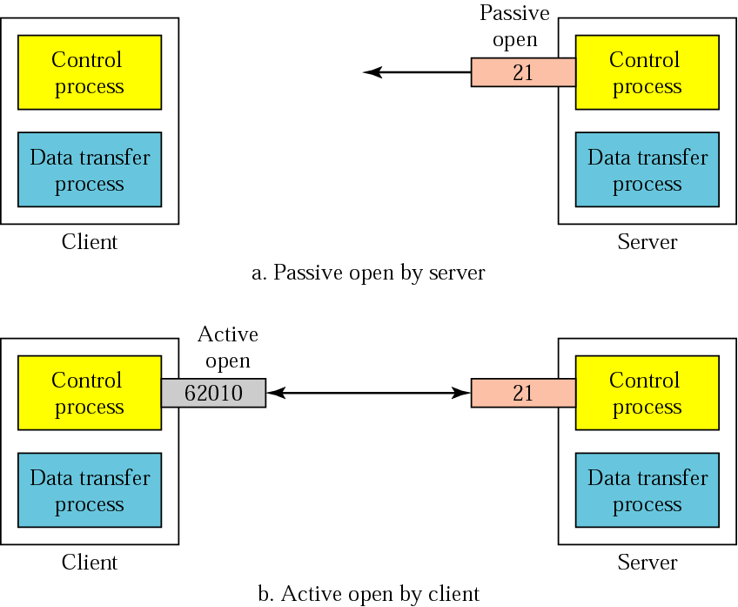
Opening the control connection
2-<number>

Slide 5
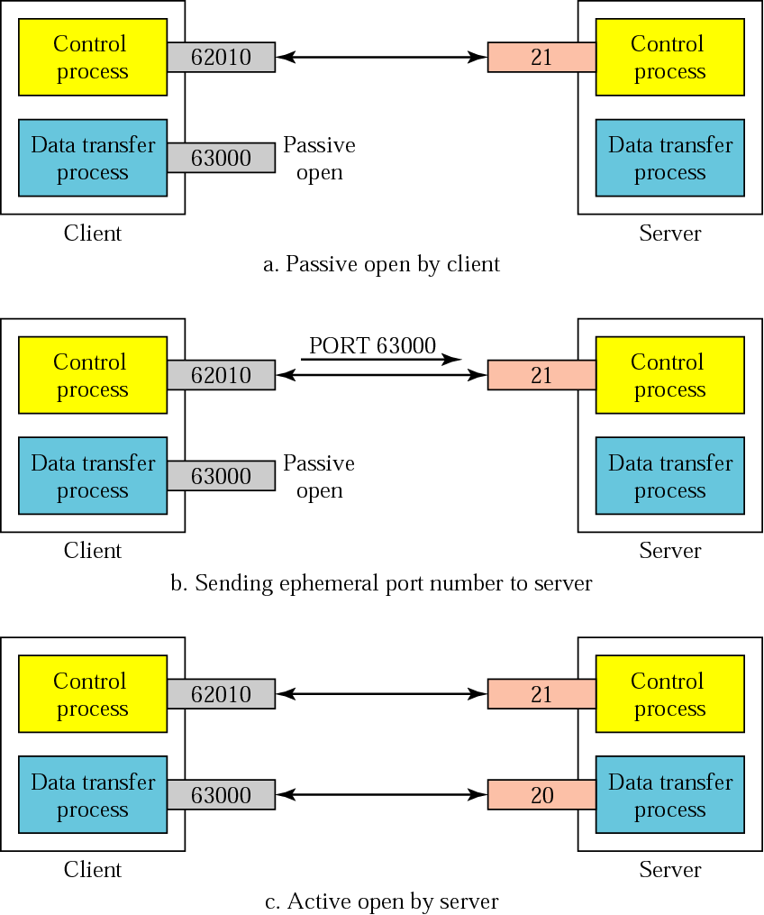
Creating the data connection
2-<number>

Slide 6
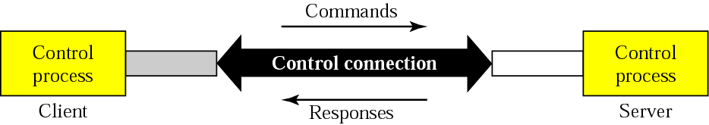
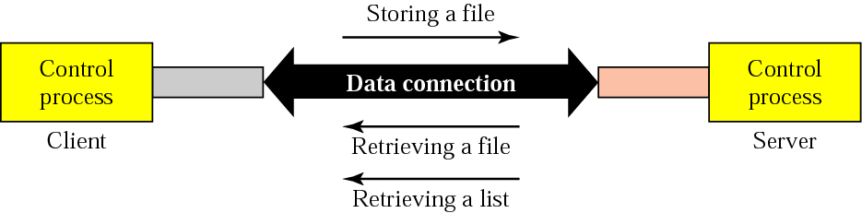
Command processing and File transfer
2-<number>

Slide 7
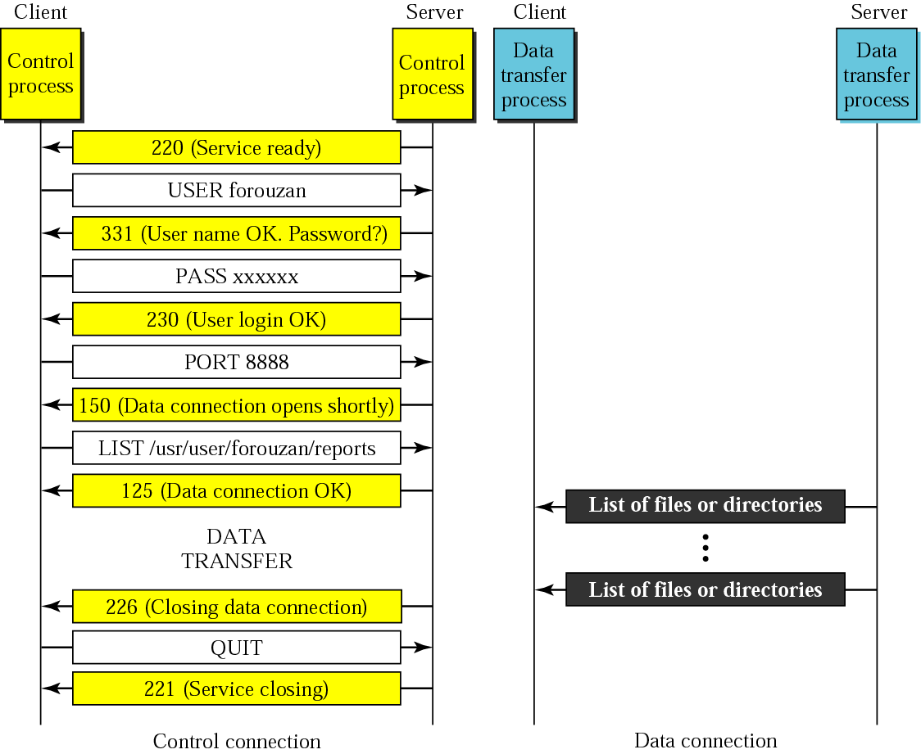
How does FTP work?
Syn
Syn - ack
Ack
TCP Control Conn is now established

Slide 8
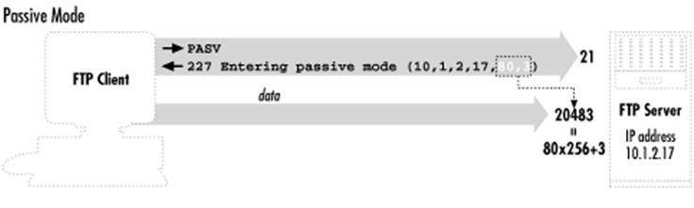
Passive FTP

